Slide 1


BIG DATA PROJECT
By : Yassine BEN MOHAMED
Appanna MACHIMANDA

Slide 2






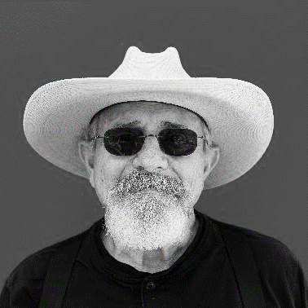
Héni GHARIANI
Yassine BEN MOHAMED
Appanna MACHIMANDA
Supervisor
Intern
Intern
Data Science student at UniLaSalle
AgTech Specialist | Planning & Development Engineer chez OKP4 - Open Knowledge
Data Science student at UniLaSalle

Slide 3
Summary
01
02
03
Main goal
TARGET
OUR PROCESS
Mapping of irrigated parcels
Using Sentinel-1 satellite images and machine learning techniques
French cooperatives (OKP4 knowledge plateform)

Slide 4
OKP4.Plateform
The OKP4 protocol has aim to encourage users to enrich information systems against retribution. It guarantees security, traceability, respect for consents and fair retribution of contributors.OKP4 thus makes it possible to maximize the sharing of data in order to optimize all systems of information.

Slide 5
Msc Agricultural & food data management, Unilasalle
The Master of Science "Agricultural & Food Data Management" is at the interface between High Technology and Agriculture & Food. It ranges from the processing of data retrieved by connected objects such as drones, satellites, tablets, telephones, data on the behavior of actors in a sector, to the management and analysis of massive data for decision support.

Slide 6
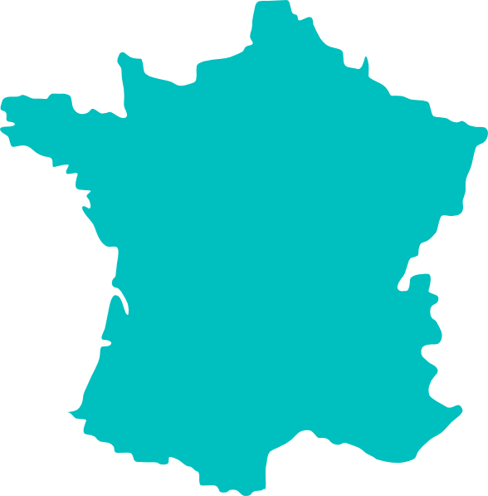

UNDERSTANDING THE PROBLEM
Several uses are possible from data from satellites, Today, in France and around the world, users rely on data provided freely and free of charge by Sentinel constellations to produce nitrogen modulation maps, biomass estimation maps, and more. maps of plant health or vigor indicators which are very useful for the farmer responsible for managing his farm, and for the agronomist responsible for providing advice on the basis of the parameters observed. As part of a vision of enriching the decentralized OKP4 data exchange platform, we are interested in setting up a Geo service for the detection of irrigated plots in France.

Slide 7



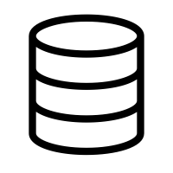

Methodology
Introduction
Research paper
Labelled dataset
Earth engine usage & Python API
Result
Tk
Tkinter interface

Slide 8
Introduction
The aim of this project was to identify if an agricultural parcel has been irrigated or not, by using remote sensing data.
Remote sensing means that we should be able to carry out our analysis without having to be physically present at the location.
This was made possible because of using Sentinel-1 satellite data. This data represents the physical characteristics of the agricultural parcel (soil water content) in terms of the signal backscatter values from vertical polarization bands.
The data is then matched with a labelled dataset of “irrigated” and “non-irrigated” classes to carry out supervised machine learning. We used SIGPAC data of Urgell region in Spain for this.

Slide 9
Research paper
Key 02
Key 04
Key 01
Key 03
We used a research paper titled “Irrigation mapping using Sentinel-1 time series at field scale” by Q. Gao, M. Zribi, M.J. Escorihuela, N. Baghdadi, P. Quintana Segui, published on 22 October 2018
The key learnings from this paper in connection with our project are :
The mean and variance of the pixel backscatter values over time, are different for the 2 classes because of the changes due to soil moisture
The Vertical polarization backscatter values of Sentinel 1 data, when considered temporally offer separability between the irrigated and non-irrigated parcels.
The Vertical polarization shows high sensitivity to soil moisture. So we use both VV(Vertical-Vertical) and VH(Vertical-Horizontal) bands.
The resolution of images is 10m and temporal resolution of the Sentinel images is about 12 days.

Slide 10
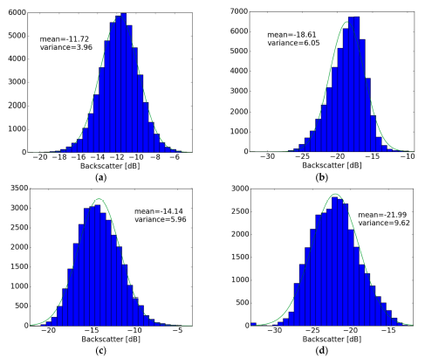
Research paper
VV
VH
Backscatter values are different for Irrigated vs Non-irrigated classes since the water content creates differences in soil dielectric constant.
Irrigated
VV mean is more sensitive to soil moisture and VH variance is more sensitive to vegetation.
The VV penetrates the soil more and the VH is susceptible to dispersion by contacting vegetation.
Non-irrigated

Slide 11
Irrigated |  |  |  | Not Irrigated
VH_mean | VH_variance | VV_mean | VV_variance | VH_mean | VH_variance | VV_mean | VV_variance
-21,8053547 | 14,23196439 | -12,41082206 | 7,481139995 | -22,3972138 | 16,55717559 | -13,7867217 | 8,061101542
-19,0454165 | 15,94858681 | -11,40373285 | 13,94855979 | -23,14136613 | 17,01204504 | -13,66727912 | 10,66690987
-17,2051128 | 15,78768167 | -10,87674928 | 13,91291006 | -23,00960737 | 30,20305834 | -14,0403085 | 16,27940799
-19,33613862 | 11,71965291 | -12,40407007 | 5,369426122 | -22,92884193 | 21,97138336 | -14,36153806 | 11,8765518
-16,35346707 | 4,999627943 | -10,28780651 | 3,908149751 | -23,99853087 | 24,06818235 | -15,63996399 | 8,282459472
-18,43107883 | 9,459681026 | -10,787711 | 5,973177064 | -19,78348444 | 6,94739556 | -11,73839858 | 4,092249622
-19,36154888 | 9,618377559 | -11,23423183 | 5,18146284 | -22,54277933 | 28,39699062 | -14,3489027 | 10,59786409
-19,78110045 | 11,13464254 | -12,2709568 | 6,661404798 | -16,56169095 | 8,879823748 | -4,68445492 | 8,338575166
-16,72651711 | 4,228032286 | -10,84145691 | 3,008602557 | -18,07165795 | 7,668036982 | -12,03294069 | 4,957430025
-17,79158129 | 4,925316865 | -11,88577002 | 3,833523697 | -14,17673725 | 11,49716677 | -9,55947044 | 7,758063164
-19,12430255 | 11,03440487 | -11,52371051 | 7,654903376 | -12,63639583 | 3,541870805 | -8,164672277 | 4,244608736
-21,70507345 | 11,15759027 | -13,05546261 | 6,756620471 | -18,29908914 | 5,357973001 | -12,78774282 | 4,046800717
-19,98635831 | 15,44302045 | -12,00186752 | 8,411362784 | -29,98423445 | 31,88895967 | -21,56557659 | 11,27349254
-20,5354466 | 18,37523036 | -12,84786523 | 11,76003011 | -29,96755558 | 22,21686435 | -21,90391098 | 11,94036617
-16,62246443 | 4,226840078 | -10,89942599 | 3,064636683 | -22,34732055 | 9,173909089 | -16,32064308 | 5,464301391
Mean
-18,92073077 | 10,81937667 | -11,64877595 | 7,128394007 | -21,32310037 | 16,35872235 | -13,6401683 | 8,525345486

Slide 12
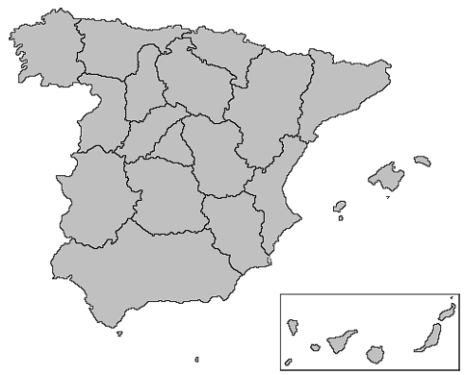
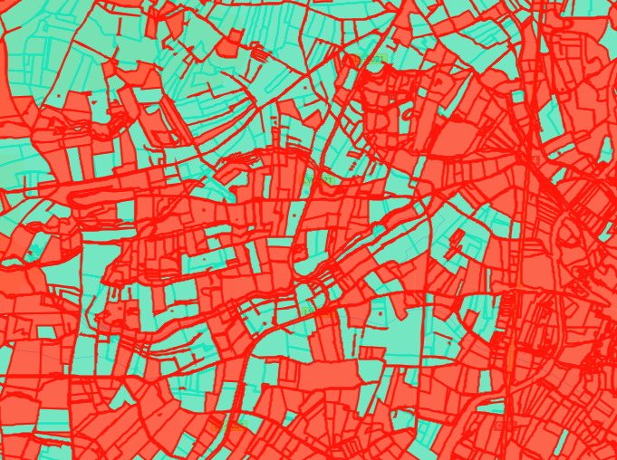
Labelled dataset
Urgell
Labelled dataset from sigpac
(Urgell 2020)
Predefined Irrigated plots
Predefined Non-Irrigated plots
Can be downloaded as shapefile
An image of Irrigated and non-Irrigated plots
(from sigpac urgell 2020)

Slide 13

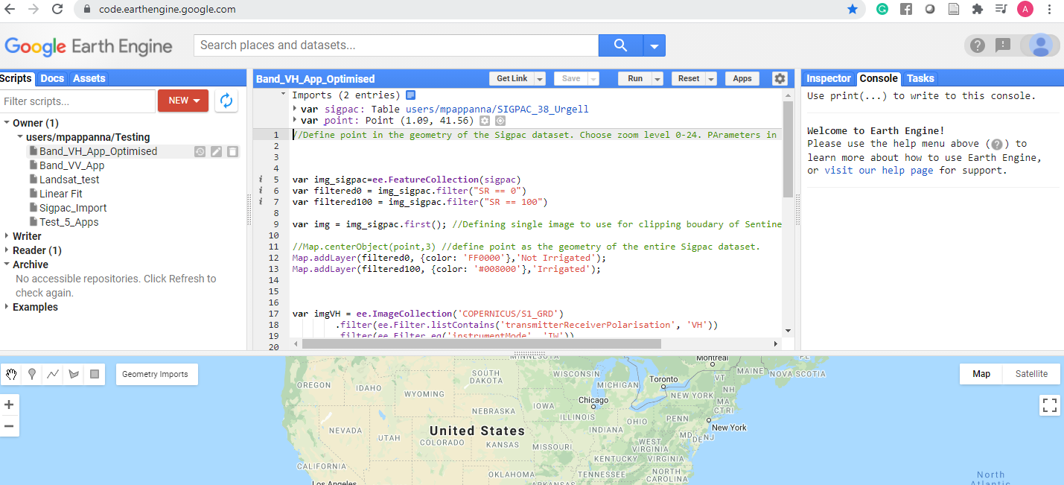
Google Earth Engine
Complete suite of geographical processing tools which run on the cloud.
This allows us to process the extremely large datasets of satellite imagery like Sentinel 1 which are several hundreds of GB in size.
In the early days of our understanding how to use Earth Engine, we directly used the Javascript API in the code console.
However, with the increasing size of our code structures, and for our eventual implementation in an easy-to-use interface, we decided to use earth engine through the Python API using the “geemap” package.

Slide 14

Python API
The geemap package requires a special installation process where a separate environment must be created with a specific version of python.
The official documentation on the google earth engine website is only for the Javascript console.
We used this to obtain conceptual understanding, and then referred to the geemap documentation to implement specific functionality.
There were many milestones we encountered in executing our solution using the Python API
Import and the Image collection of Sentinel 1 data “COPERNICUS/S1_GRD”
1
5
Selecting the machine learning model and defining number of points and scale.
Ingest the SIGPAC data into Earth Engine and import the feature collection into the python workbook.
Exporting the model classified output of the same labelled dataset used for training.
2
6
Define a default scope of Sentinel data to load geographically, temporally, and by the selected properties.
3
7
Optimizing the points, and scale for best output match.
Clip the sentinel data to the boundary geometry of the sigpac data so that resources are not wasted in rendering irrelevant pixel data.
Defining the prediction zone and obtaining the output.
4
8

Slide 15

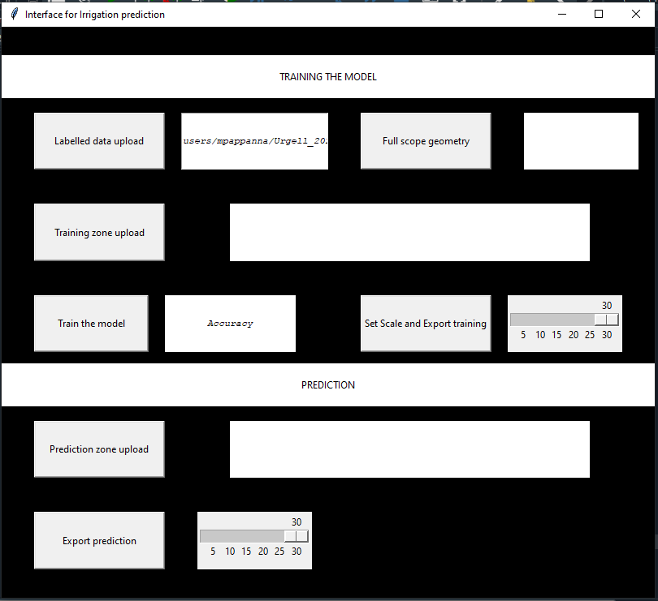
Tkinter interface
The tkinter package ("Tk interface") is the standard Python interface to the Tk GUI toolkit. The tkinter package ("Tk interface"). Python's Tkinter ("Tk interface") module allows us to create graphical interfaces.

Slide 16
Tkinter interface steps
Step 02
Step 04
Step 01
Step 03
A “Training Zone” is an area selection within the labelled dataset geometry, so that a region with a good distribution of irrigated and non-irrigated classes can be used for training. If this is not uploaded, the training scope defaults to the full scope of the labelled dataset.
Now we can set the scale for export and click the button to generate a .tif image of the classified training zone.
The “table ID” of the SIGPAC data (ingested into Earth engine) has to be pasted beside the “Labelled data upload” button. After pasting, the button is clicked to load the data.
Step 05
The “Full scope geometry” is the geojson file which contains the outline of the labelled dataset (SIGPAC data).
Then we can click the “Train the model” button. After the model completes training, the accuracy is displayed beside the button.

Slide 17
Tkinter interface steps
Step 07
Step 06
To run a prediction, we can upload the geojson file of the region (Occitanie in our case) and then setting the scale and exporting the predition result as a .tif image.
The export process can take a very long time based on the scale which has been set. However once the task has been initiated, the process runs on the earth engine cloud and downloads the output into the associated google drive account.

Slide 18
Results
1
5
3
The count of pixels in each parcel of the predicted image, varies based on the scale of export. A scale of 30m will have bigger pixels and hence lesser count compared to a scale of 5m which will have smaller pixels and hence more count.
For prediction on the Occitanie region, a scale 30 or 20 export results in a single .tif image. Scale 10 produces 2 images and a scale 5 produces 8 images. If multiple images are produced, they have to be merged using a tool like QGIS.
In our case, we ran prediction for the entire Occitanie region. We retrieved the agricultural parcel boundaries from RPG (Registre parcellaire graphique) data.gouv.fr official website.
6
2
4
To run prediction on any department, only the boundary geojson file is required. This can be downloaded readily from a web search. For predicting a specific region, the boundary can be drawn using a website tool like geojson.io
The parameters for the training of the model is fixed in the backend and cannot be changed in the interface. We used a random forest classifier model. For sampling the data, 20k random points were blasted onto the SIGPAC dataset where each point samples pixels at a scale of 30m. If the scale is set to be smaller than this, the training data becomes more sensitive to the intra parcel variation of pixel backscatter values and negatively affects the model performance for predictions.
Using qgis software, we calculated the zonal statistics for each parcel. If the percentage of irrigated pixels in a parcel is more than 50%, then we can conclude that the parcel has been irrigated.

Slide 19
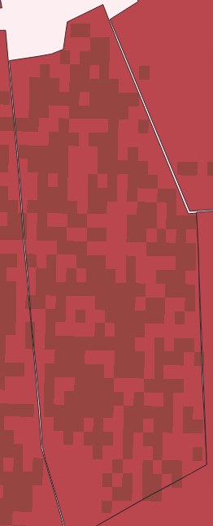
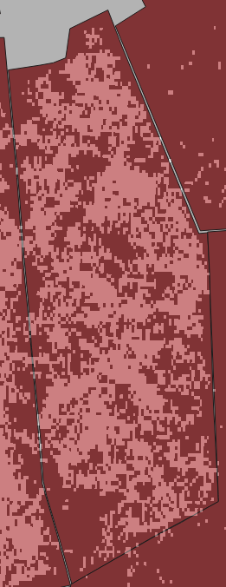
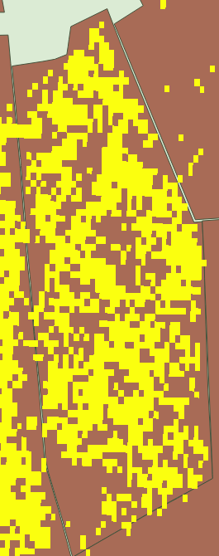


Results
For most parcels, an output of scale 10 gives reliable results.
Reliable results are judged by sufficient count of pixels.
For large parcels, scale 20 can also be used and the resolution of the prediction matches that of scale 10 and scale 5.
For very small parcels, scale 20 and scale 10 may not show any output. Only scale 5 can be used reliably in this case.
Exporting a scale 5 prediction image takes a very long time and has very large file size.
The zonal statistics for the parcels are exported into an excel file for ready reference.
Fid: 19875
ID_ILOT: 6034280
Area:156 km²
Scale 20
Irr: 50.9%
Count: 535
Scale 10
Irr: 50.6%
Count: 2145
Scale 5
Irr: 50.6%
Count: 8572
Fid: 357387
ID_ILOT: 1971580
Area:101 m²
Scale 20
Irr: 0%
Count: 0.35
Scale 10
Irr: 0%
Count: 2
Scale 5
Irr: 80%
Count: 5

Slide 20
Conclusion
The skills required to create a process and tool for remotely identifying irrigated parcels : python programming, QGIS software, Google Earth Engine.
The interface tool can be used by anyone for generating the training and prediction images. These images have to be manually loaded into QGIS software to compute the zonal statistics and identify if a parcel has more than 50% of the pixels classified as “Irrigated”.
The scale and number of sampling points are the key parameters for training the classifier. We need to have sufficient points to represent the parcels. Scale has to be low enough to represent the variation in backscatter values but high enough to not be too sensitive to the target label of training.
A training zone incorporating a good mix of both irrigated and non irrigated classes can further improve the training of the model.
The scale of export is an important consideration because smaller scale requires more computation time and a heavy output image file size.
Google Earth Engine allows us to use massive computational resource in order to use this tool. Still the size and scale of these images resulted in slow render times during the development of our program.
Further improvements to this tool can be incorporated to allow full functionality of predictions for non-technical users as well. Ideally a map interface can be included to define prediction areas on the fly and obtain a percentage of irrigation classification.

Slide 21
References
Q. Gao, M. Zribi, M.J. Escorihuela, N. Baghdadi, P. Quintana Segui. Irrigation mapping using,Sentinel-1 time series at field scale. Remote Sensing, MDPI, 2018, 10 (9), 18 p. 10.3390/rs10091495.hal-01900567
https://developers.google.com/earth-engine
https://code.earthengine.google.com/
https://analisi.transparenciacatalunya.cat/Medi-Rural-Pesca/Sistema-d-informaci-geogr-fica-de-parcel-les-agr-c/5ytz-a6f2
https://github.com/giswqs/geemap/tree/master/examples
https://docs.python.org/3/library/tkinter.html

